Slide 1
Sociology Course Code (SS 2005)
Muhammad Zeeshan

Slide 2
What Is the Sociological Perspective?
The sociological perspective reveals the power of society to shape individual lives.
• What we commonly think of as personal choice—whether or not to go to college, how many children we will have, even the decision to end our own life—is affected by social forces.
• Peter Berger described the sociological perspective as “seeing the general in the particular.”
• C. Wright Mills called this point of view the “sociological imagination,” claiming it transforms personal troubles into public issues.
• The experience of being an outsider or of living through a social crisis can encourage people to use the sociological perspective.

Slide 3
THE SOCIOLOICAL VIEW:-
Seeing the General in Particular:-
One good way to define the sociological perspective is seeing the general in the particular (Berger, 1963).
This definition tells us that sociologists look for general patterns in the behavior of particular people.
Although every individual is unique, a society shapes the lives of people in patterned ways that are evident as we discover how various categories (such as children and adults, women and men, the rich and the poor) live very differently.
We begin to see the world sociologically by realizing how the general categories into which we fall shape our particular life experiences.

Slide 4
IMPORTANCE OF GLOBAL PERSPECTIVE:-
As new information technology draws even the farthest reaches of the planet closer together, many academic disciplines are taking a global perspective, the study of the larger world and our society’s place in it.
Q# What is the importance of a global perspective for sociology?
Ans: Global awareness is a logical extension of the sociological perspective. Sociology shows us that our place in society shapes our life experiences. It stands to reason, then, that the position of our society in the larger world system affects everyone in Pakistan.

Slide 5
THE IMPORTANCE OF A GLOBAL PERSPECTIVE
Where we live—in a high-income country like the United States, a middle income country such as Brazil, or a low-income country such as Mali—shapes the lives we lead.
Societies throughout the world are increasingly interconnected.
• New technology allows people around the world to share popular trends.
• Immigration from around the world increases the racial and ethnic diversity of the United States.
• Trade across national boundaries has created a global economy.
Many social problems that we face in our societies are far more serious in other countries. Learning about life in other societies helps us learn more about ourselves.

Slide 6
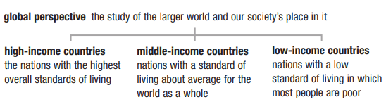
DIVISION OF COUNTRIES ACCORDING TO WEALTH AND INCOME

Slide 7
IMPORTANCE OF GLOBAL PERSPECTIVE:-
Understanding the global perspective is important because of the following reasons:-
Where we live shapes the lives we lead.
Societies throughout the world are increasingly interconnected.
Many social problems that we face in our society can be far more serious elsewhere.
Thinking globally helps us learn more about ourselves.

Slide 8
Sociological investigation
Sociological investigation starts with two simple requirements. The first was the focus of Chapter 1: Apply the sociological perspective. This point of view reveals curious patterns of behavior all around us that call for further study. It was Lois Benjamin’s sociological imagination that prompted her to wonder how race affects the lives of talented African Americans.
This brings us to the second requirement: Be curious and ask questions. Benjamin wanted to learn more about how race affects people who are high achievers. She began by asking questions: Who are the leaders of this nation’s black community? What effect does being part of a racial minority have on their view of themselves? On the way white people perceive them and their work? Seeing the world sociologically and asking questions are basic to sociological investigation. As we look for answers, we need to realize that there are various kinds of “truth.”

Slide 9
Science as One Type of Truth
Saying that we “know” something can mean many things. Most people in the United States, for instance, say they believe in God. Few claim to have direct contact with God, but they say they believe all the same. We call this kind of knowing “belief” or “faith.” A second kind of truth comes from recognized experts. Students with a health problem, for example, may consult a campus physician or search the Internet for articles written by experts in the field. A third type of truth is based on simple agreement among ordinary people. Most of us in the United States would probably say we “know” that sexual intercourse among ten-year-old children is wrong. But why? Mostly because just about everyone says it is.
Science represents a fourth way of knowing. Science is a logical system that bases knowledge on direct, systematic observation. Standing apart from faith, the wisdom of “experts,” and general agreement, scientific knowledge rests on empirical evidence, that is, information we can verify with our sense

Slide 10
COMMON SENSE V/S SCIENTIFIC EVIDENCE
COMMON SENSE:-
Common sense can be defined as an understanding of everyday challenges and situations gained through observations, experiences and interactions with those around us, combined with beliefs and knowledge acquired from interactions among us all. For e.g. looking in both directions when walking down a street, eating healthily and exercising to maintain good health.
SCIENCE:-
Science is a systematic and evidence-based way of exploring our world through observation, experimentation and data analysis. It follows the scientific method i.e. an organized way of testing hypotheses with experimentation or observation with its aim being to better comprehend the natural phenomena as well as predict the future for betterment of humans.

Slide 11
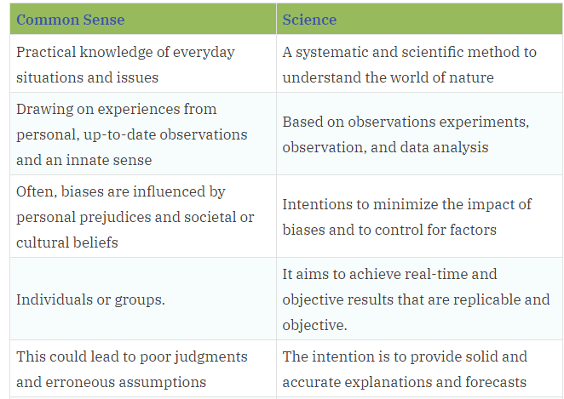

Slide 12
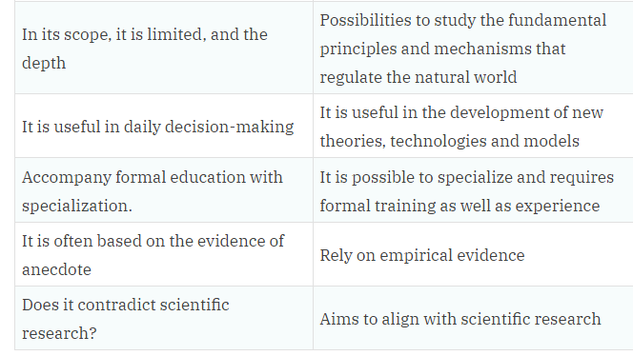

Slide 13
Common Sense versus Scientific Evidence Like the sociological perspective, scientific evidence sometimes challenges our common sense. Here are six statements that many North Americans assume are true:
1. “Poor people are far more likely than rich people to break the law.” Not true. If you regularly watch television shows like COPS, you might think that police arrest only people from “bad” neighborhoods. Chapter 9 (“Deviance”) explains that poor people do stand out in the official arrest statistics. But research also shows that police and prosecutors are more likely to treat well-to-do people more leniently, as when a Hollywood celebrity is accused of shoplifting or drunk driving. Some laws are even written in a way that criminalizes poor people more and affluent people less.
2. “The United States is a middle-class society in which most people are more or less equal.” False. Data presented in Chapter 11 (“Social Class in the United States”) show that the richest 5 percent

Slide 14
of U.S. families control 60 percent of the nation’s total wealth, but almost half of all families have scarcely any wealth at all. The gap between the richest people and average people in the United States has never been greater (Mishel, Bernstein, & Allegretto, 2009; Wolff, 2010).
3. “Most poor people don’t want to work.” Wrong. Research described in Chapter 11 indicates that this statement is true of some but not most poor people. In fact, more than a third of poor individuals in the United States are children and elderly people who are not expected to work.
4. “Differences in the behavior of females and males are just ‘human nature.’ ” Wrong again. Much of what we call “human nature” is constructed by the society in which we live, as Chapter 3 (“Culture”) explains. Further, as Chapter 13 (“Gender Stratification”) argues, some societies define “feminine” and “masculine” very differently from the way we do.
5. “People change as they grow old, losing many interests as they focus on their health.” Not really. Chapter 15 (“Aging and the Elderly”) reports that aging does very little to change our personalities. Problems of health increase in old age, but by and large, elderly people keep the distinctive personalities they have had throughout their adult lives.

Slide 15
6. “Most people marry because they are in love.” Not always. To members of our society, few statements are so obvious. Surprisingly, however, in many societies, marriage has little to do with love. Chapter 18 (“Families”) explains why.
These examples confirm the old saying that “it’s not what we don’t know that gets us into trouble as much as the things we do know that just aren’t so.” The Sociology in Focus box explains why we also need to think critically about “facts” we find on the Internet and in the popular media. While growing up we have all heard many widely accepted “truths,” been bombarded by “expert” advice in the popular media, and felt pressure to accept the opinions of people around us. As adults, we need to evaluate more critically what we see, read, and hear. Sociology can help us do that.

Slide 16
SCIENCE AND SOCIOLOGY:-
So it was that the French social thinker Auguste Comte (1798–1857) who coined the term sociology in 1838 to describe a new way of looking at society.
This makes sociology one of the youngest academic disciplines— far newer than history, physics, or economics, for example.
Comte’s contribution came in applying the scientific approach—first used to study the physical world—to the study of society.
Comte’s approach is called positivism, a way of understanding based on science.
As a positivist, Comte believed that society operates according to its own laws, much as the physical world operates according to gravity and other laws of nature.

Slide 17
COMTE’S 3 STAGES OF DEVELOPMENT:-
Comte saw sociology as the product of a three-stage historical development.
Auguste Comte's law of three stages states that society as a whole, and each particular science, develops through three mentally conceived stages. The three stages are:
The theological stage, in which the world and the place of humans within it were explained in terms of gods, spirits, and magic.
The metaphysical stage, in which such explanations were based on abstract notions such as essences and final causes.
The positive stage, based on scientific knowledge

Slide 18
Q&A Session

